Slide 1

Management of Environmental hazards/ Disaster Management
ENV 103

Slide 2
Efforts must be taken by environment or disaster management planners to minimize the impacts of environmental hazards through proper environmental hazard/disaster management planning.
Disaster management can be defined as the organization and management of resources and responsibilities for dealing with all humanitarian aspects of emergencies, in particular preparedness, response and recovery in order to lessen the impact of disasters.

Slide 3
Phases of disaster management
Preventions and /mitigation
Preparedness
Emergency response
Recovery and rehabilitation

Slide 4
Phase 1: Preventions and/ Mitigation
It is a long term plan and activities for eliminating damage from hazards.
Human beings cannot prevent the environmental hazards.
They can find out some measures to mitigate the problems of environmental hazards.
Plinth level of the houses may be increased
Embankment

Slide 5
Phase 2 : Preparedness
Short time measure to reduce the impact of hazards which is impending.
- Forecast
-Warning
-Evacuation
-Stock piling of food and medical supplies

Slide 6
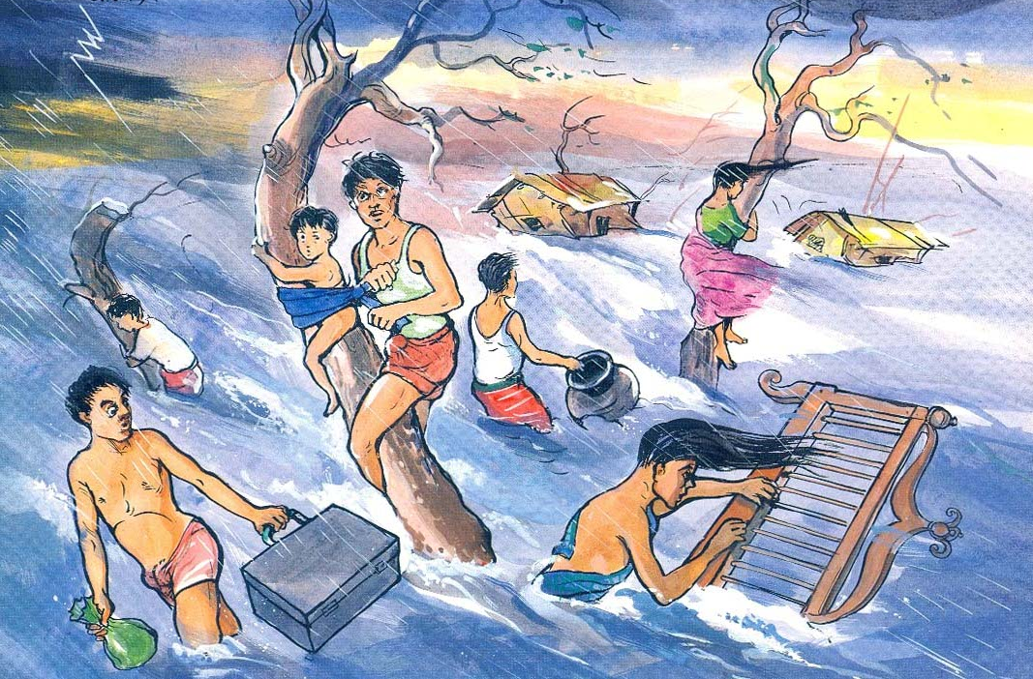
Fighting during disaster

Slide 7
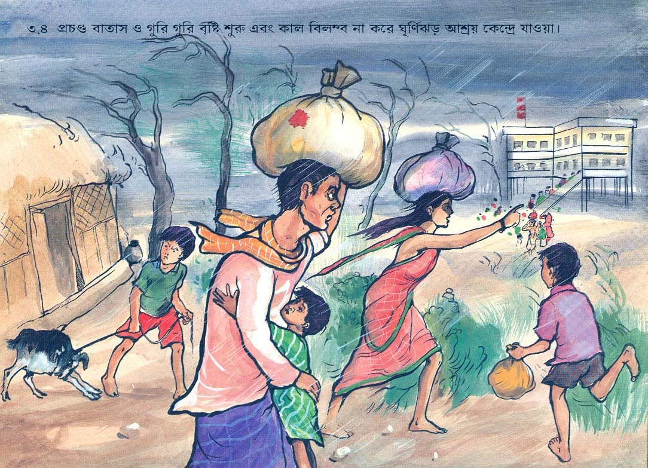
Going to cyclone shelter

Slide 8
Phase 3: Emergency response
Emergency action taken during the onset of hazards to save lives and properties
Search and rescue
Evacuation of injured or endangered people
Restoration of vital facilities and utilities
Arrangement of emergency relief
Arrangement of medical and health services
Organization of emergency communication

Slide 9
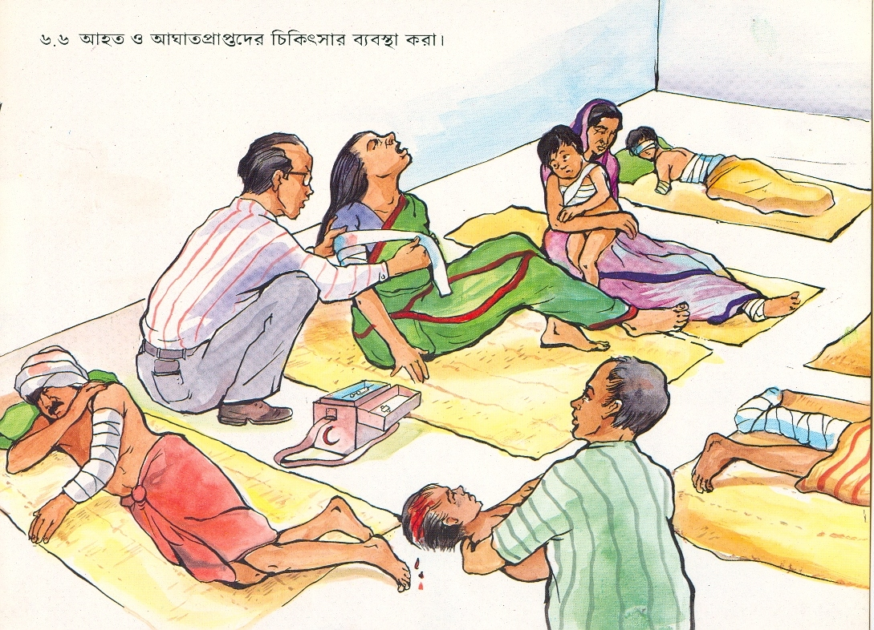
Providing medical support for injured people

Slide 10
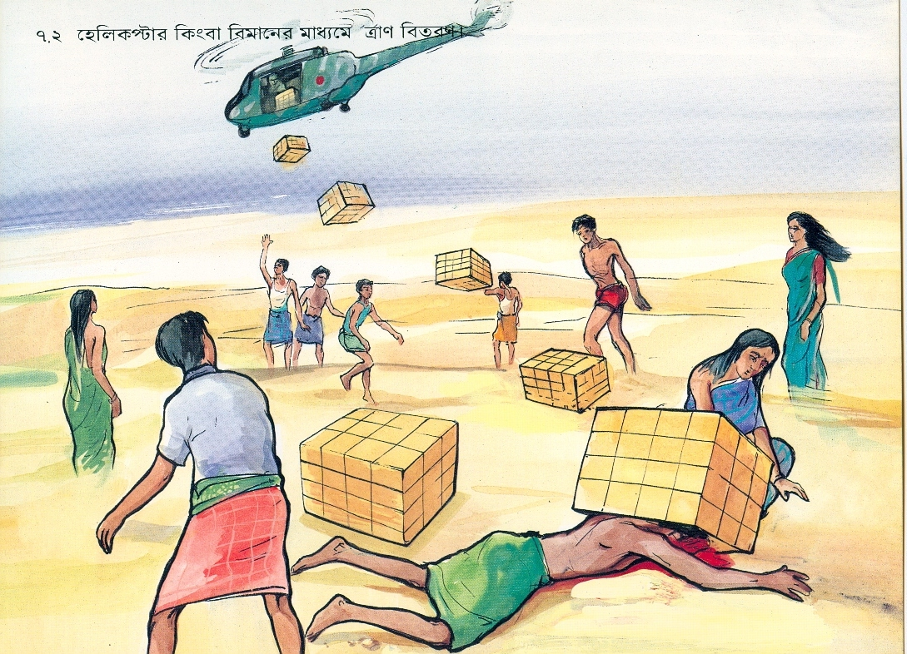
Providing relief

Slide 11
Phase 4: Recovery and rehabilitation
Activities after the emergency period is over, such as
Rehabilitation
Reconstruction
Future plan
Concern about poor people
Post flood economic assistance to the low income families
Stable life for the citizen
Demonstration project
Improved self reliance
Improvement of prevention, preparedness and emergency measures

Slide 12
Management of flood hazard
Keep flood water away from people
Structural measures
Construction of embankment along the banks of the river
Channel improvement work
-Removal sediment from the main river and the distributaries
-Diverting of flood flow
Construction of storage reservoir
Keep people away from flood water
Flood plain zoning
Development of flood forecasting and warning system

Slide 13
THANK YOU

